Slide 1
Pushdown Automata PDAs
1

Slide 2
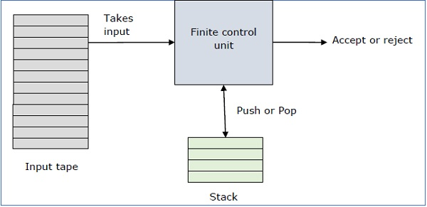
PDA
Memory in the form of finite stack (LIFO)
Transition from one state to another is based on current state, input and TOS only.
(Q,Ʃ, δ, Z0, Γ,q0,F)
Δ : (Q x Σ x Γ) → Q x Γ*

Slide 3
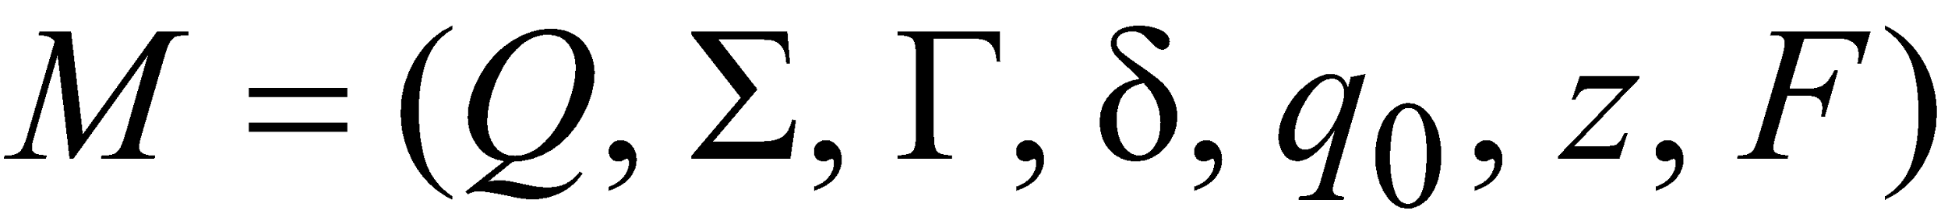
Formal Definition
Pushdown Automaton (PDA)
δ: Q x (Σ U {ε}) x Г → finite subsets of Q x Г*
Accept
states
States
Input
alphabet
Stack
start
symbol
Transition
function
Initial
state
Stack
alphabet
3

Slide 4


Initial Stack Symbol
Stack
Stack
stack
head
top
bottom
special symbol
Appears at time 0
4

Slide 5
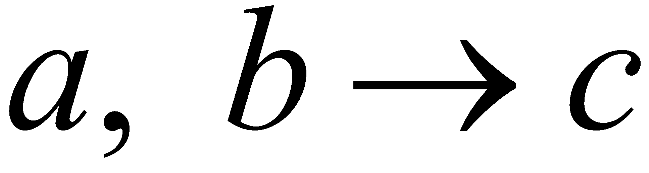
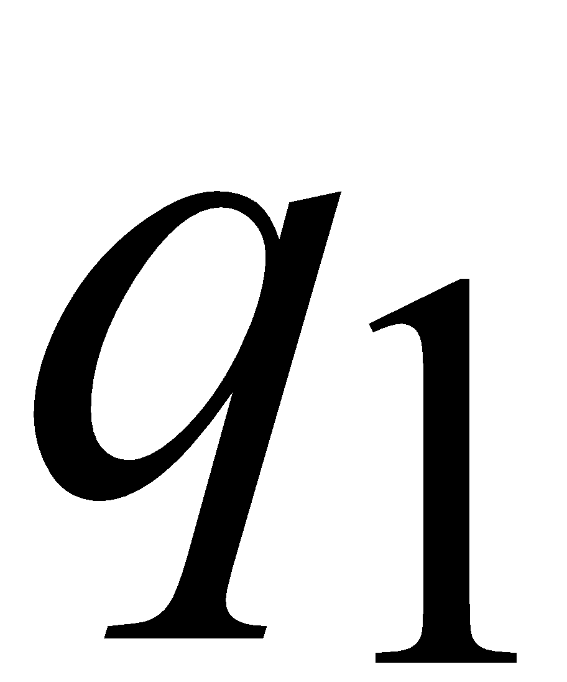
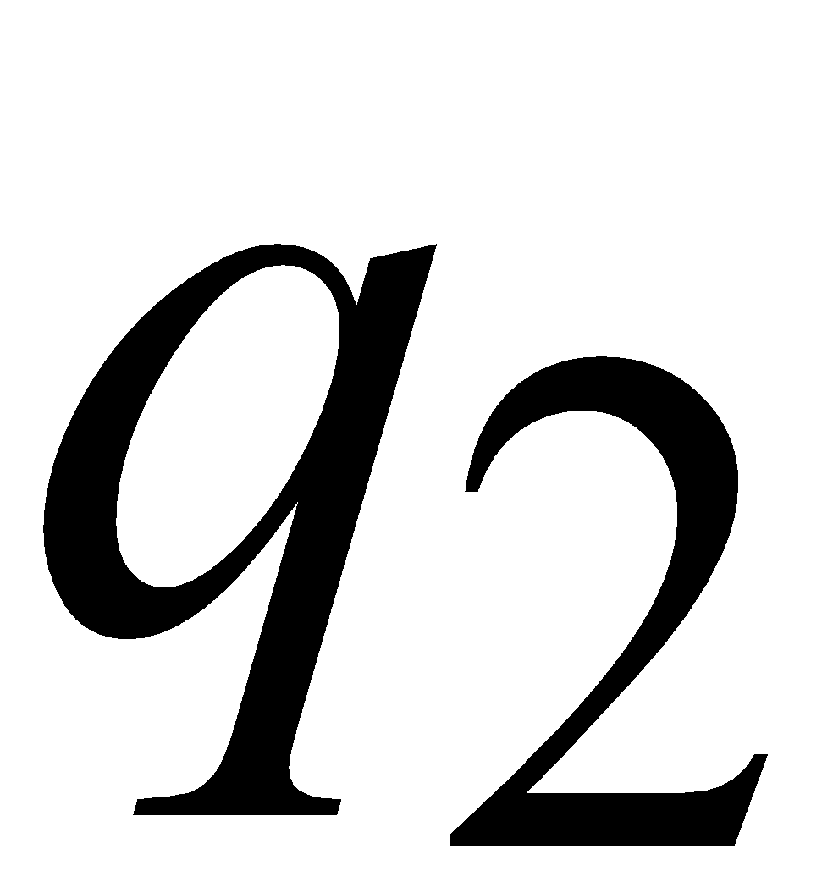
The States
Input
symbol
Pop
symbol
Push
symbol
δ (q1, a, b) = (q2,c)
5

Slide 6




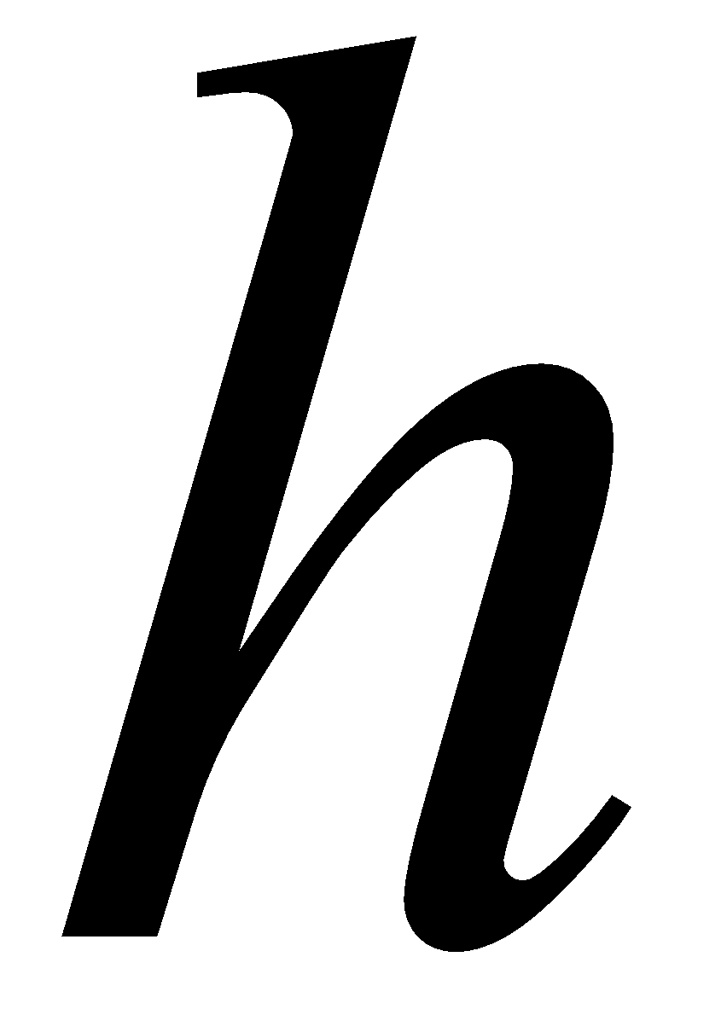


Replace ToS: δ (q1, a, b) = (q2,c)
input
stack
top
Replace
6

Slide 7
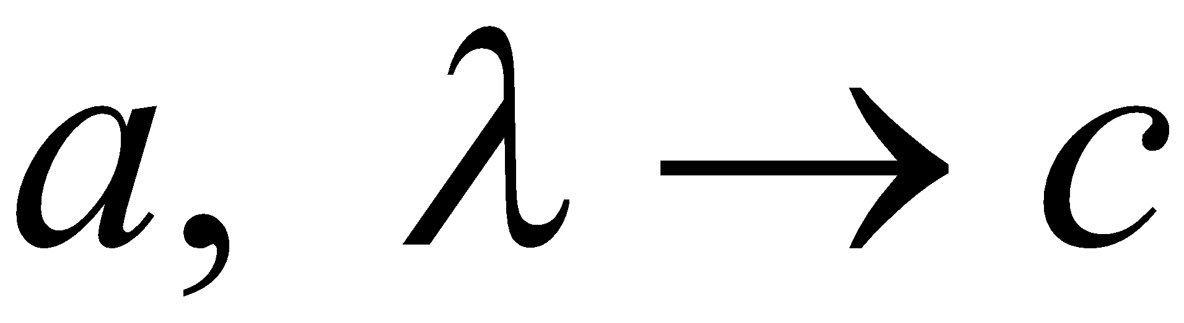
Push: δ (q1, a,λ ) = (q2,c)
input
stack
top
Push
7

Slide 8
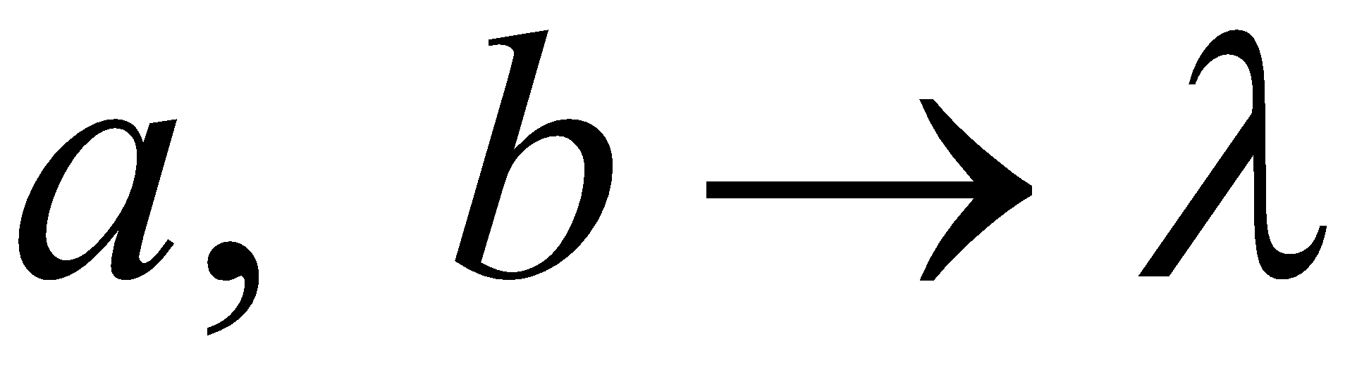
Pop: δ (q1, a,b ) = (q2,λ)
input
stack
top
Pop
8

Slide 9
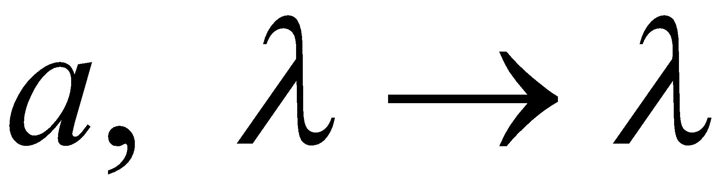
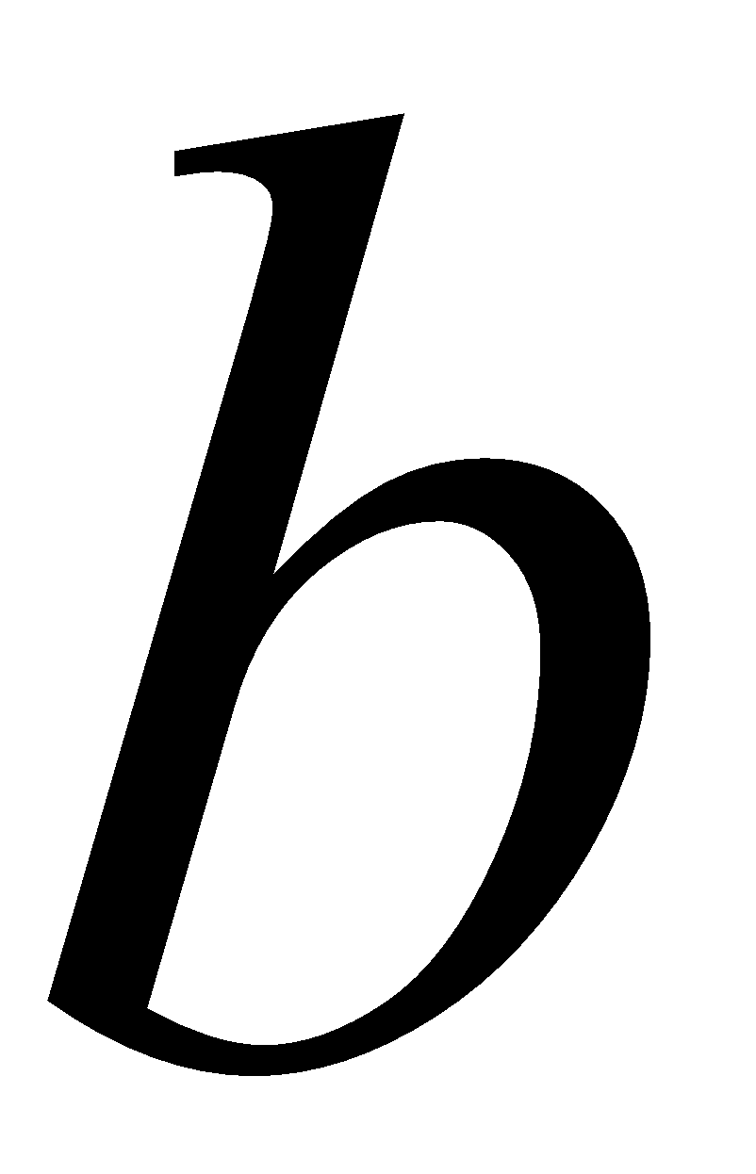
δ (q1, a,λ ) = (q2,λ)
input
stack
top
No Change
9

Slide 10
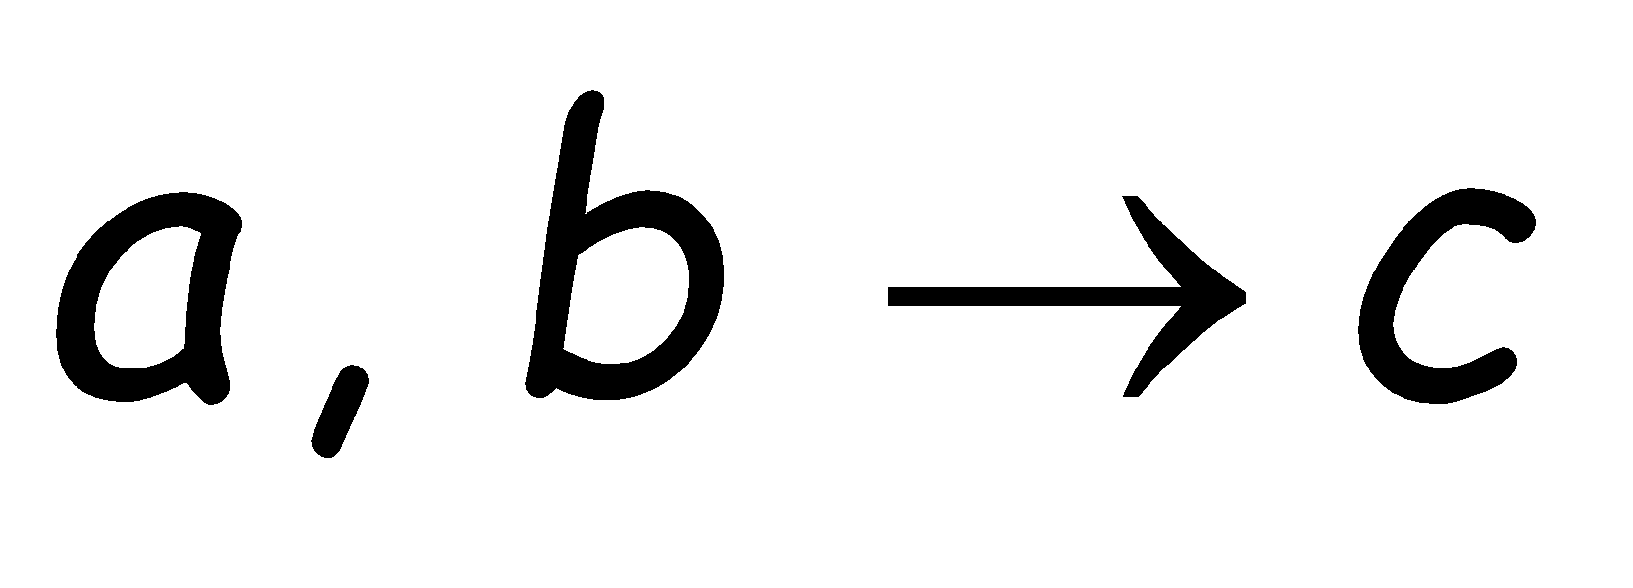
Acc:Pop from Empty Stack
input
Pop
Automaton halts!
stack
top
If the automaton attempts to pop from
empty stack then it halts and rejects input
10

Slide 11
Push: (q0 , a , z0) → (q1,a z0) No change: (q0 , a , z0) → (q1,z0) Pop: (q0 , a , a) → (q1, ˄)

Slide 12
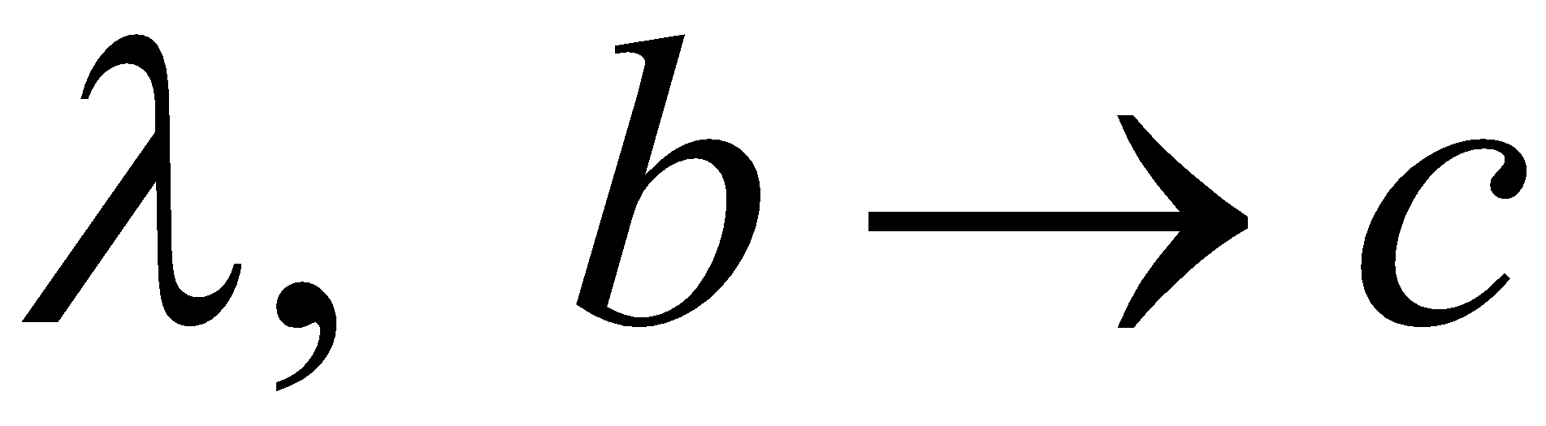
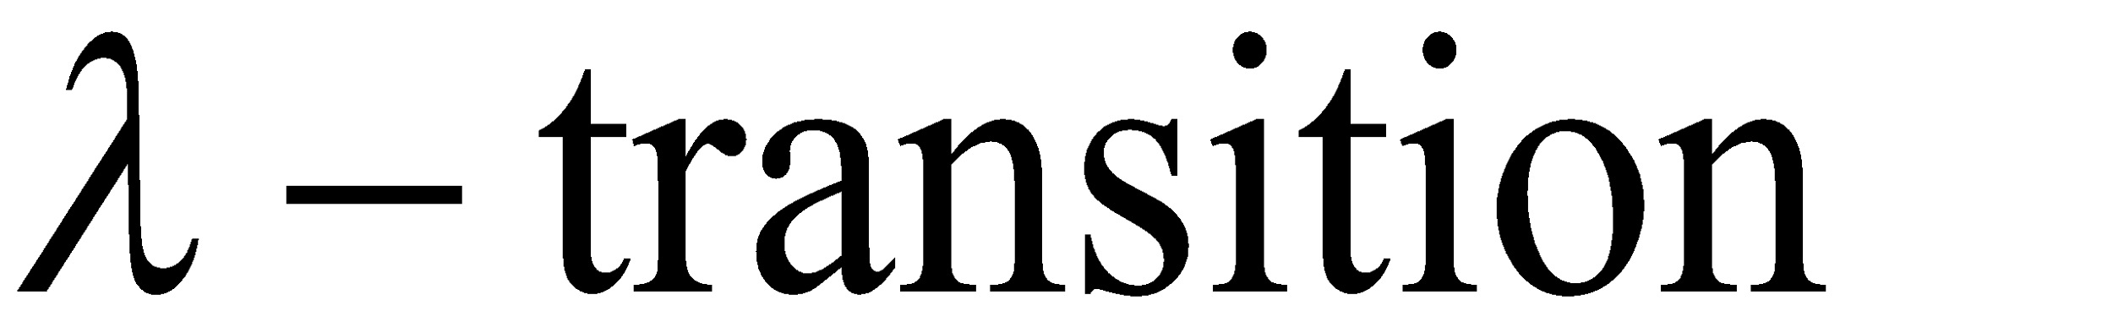
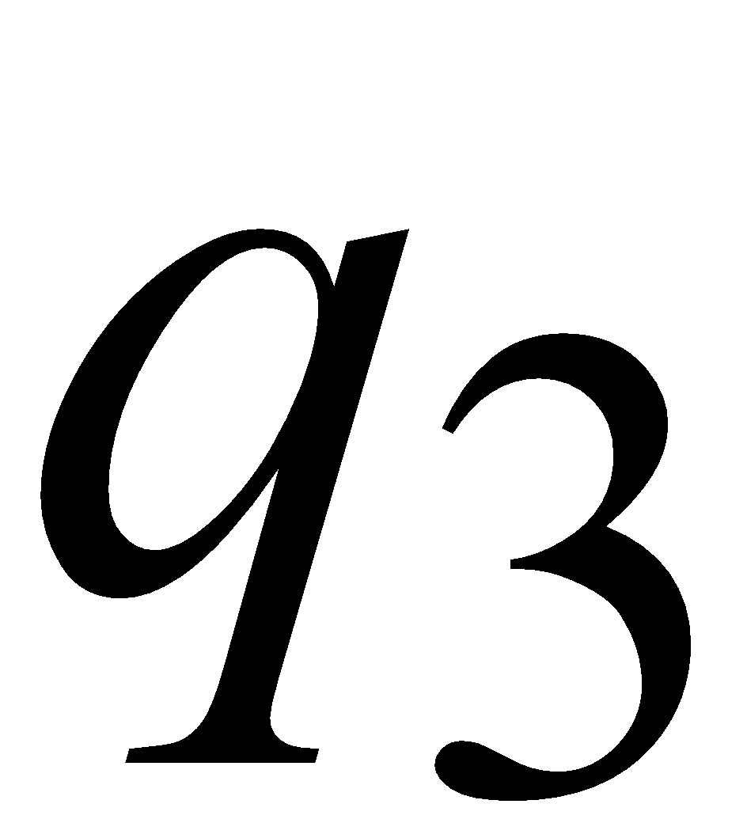
Non-Determinism
PDAs are non-deterministic
Allowed non-deterministic transitions
12

Slide 13
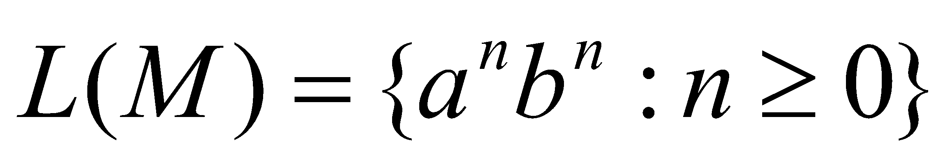

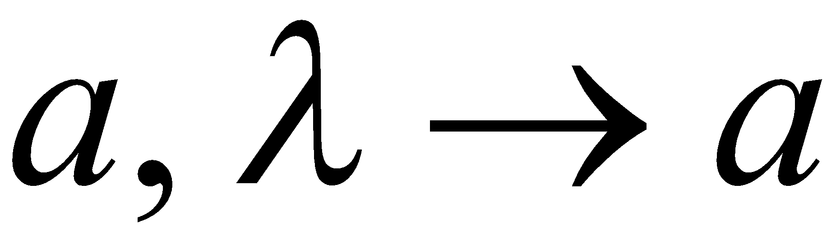
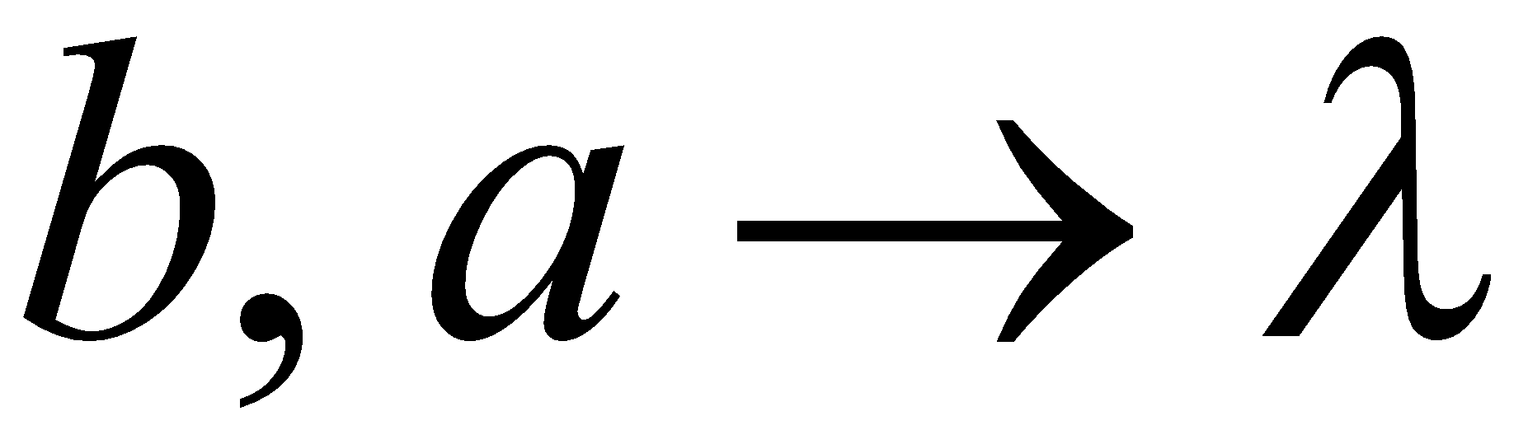
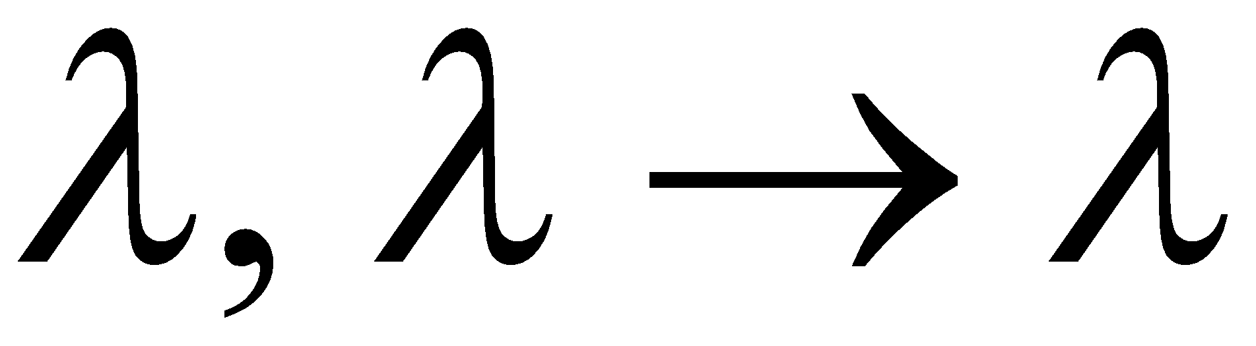
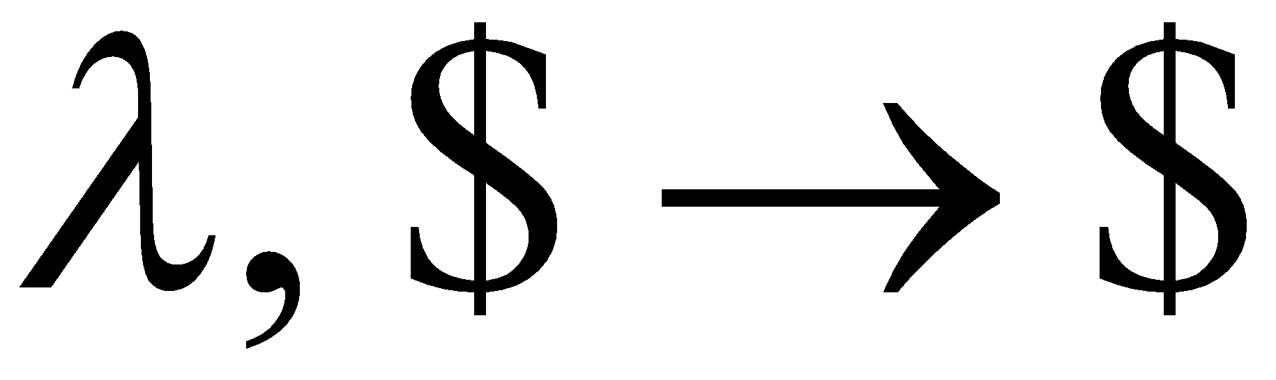
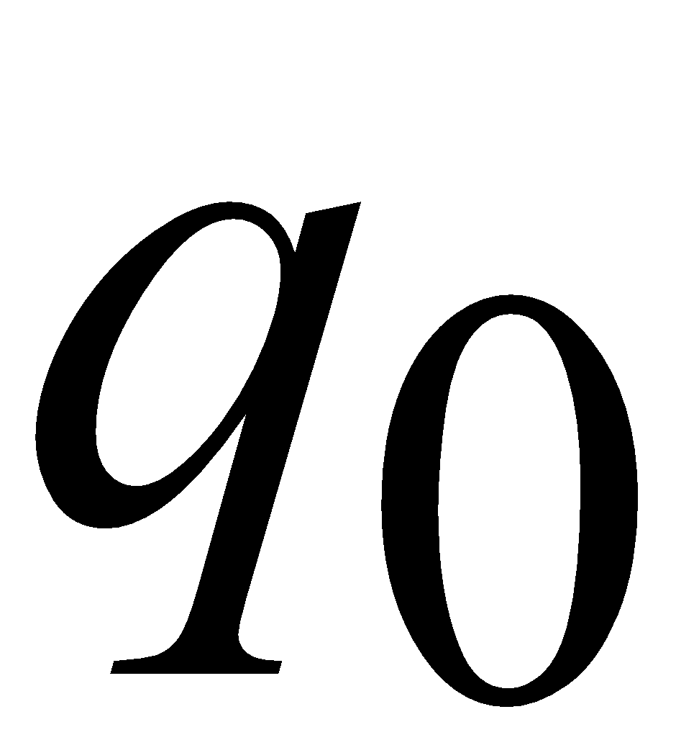
Example PDA
PDA :
13

Slide 14
Basic Idea:
Push the a’s
on the stack
2. Match the b’s on input
with a’s on stack
3. Match
found
14

Slide 15
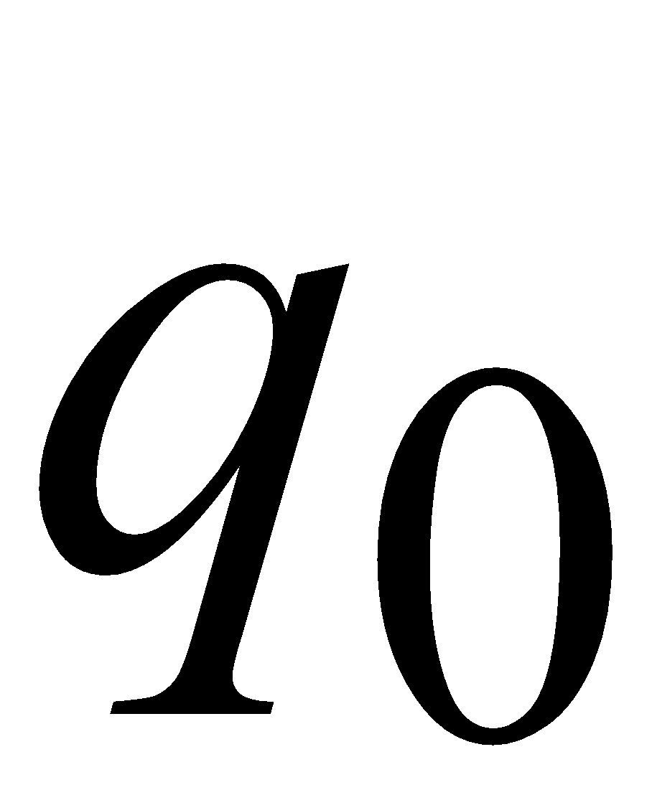
Execution Example:
Time 0
Input
Stack
current
state
15

Slide 16
Time 1
Input
Stack
16

Slide 17
Time 2
Input
Stack
17

Slide 18
Time 3
Input
Stack
18

Slide 19
Time 4
Input
Stack
19

Slide 20
Time 5
Input
Stack
20

Slide 21
Time 6
Input
Stack
21

Slide 22
Time 7
Input
Stack
22

Slide 23
Time 8
Input
Stack
accept
23

Slide 24
A string is accepted if there is
a computation such that:
All the input is consumed
AND
The last state is an accepting state
we do not care about the stack contents
at the end of the accepting computation
24

Slide 25
Rejection Example:
Time 0
Input
Stack
current
state
25

Slide 26
Rejection Example:
Time 1
Input
Stack
current
state
26

Slide 27
Rejection Example:
Time 2
Input
Stack
current
state
27

Slide 28
Rejection Example:
Time 3
Input
Stack
current
state
28

Slide 29
Rejection Example:
Time 4
Input
Stack
current
state
29

Slide 30
Rejection Example:
Time 4
Input
Stack
reject
current
state
30

Slide 31
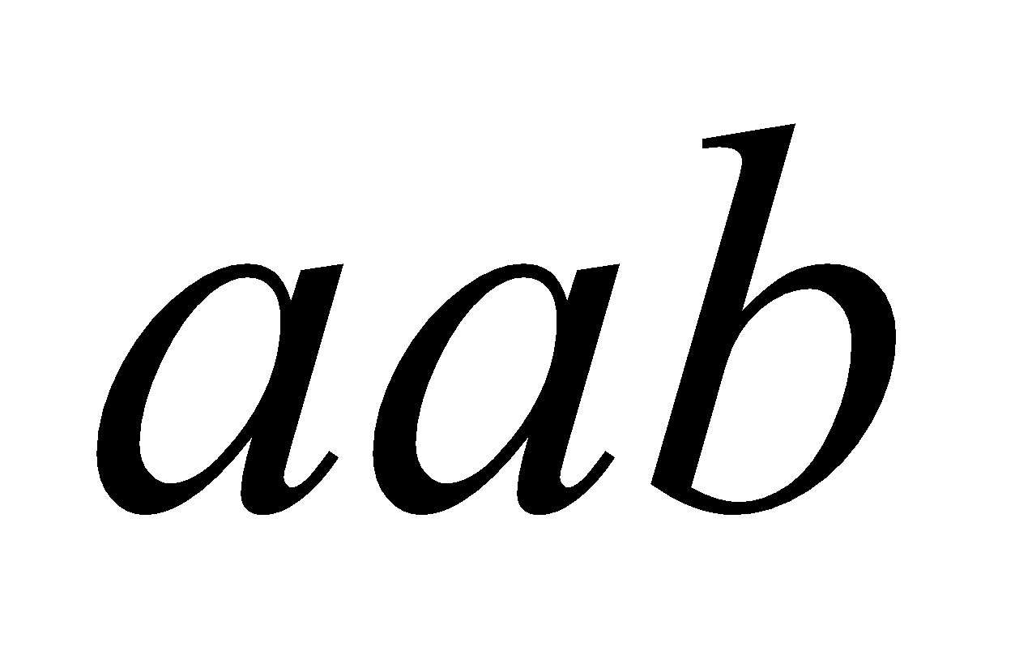
There is no accepting computation for
The string is rejected by the PDA
31

Slide 32
Homework
Balanced parenthesis
((())()), or (())(), but not-in-language: ((())
32

Slide 33
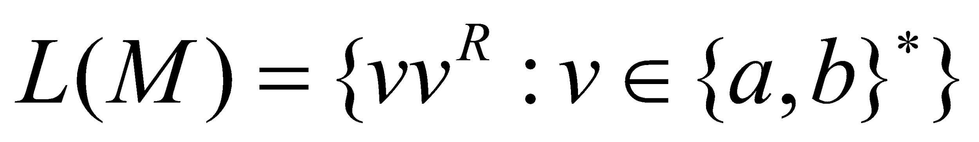
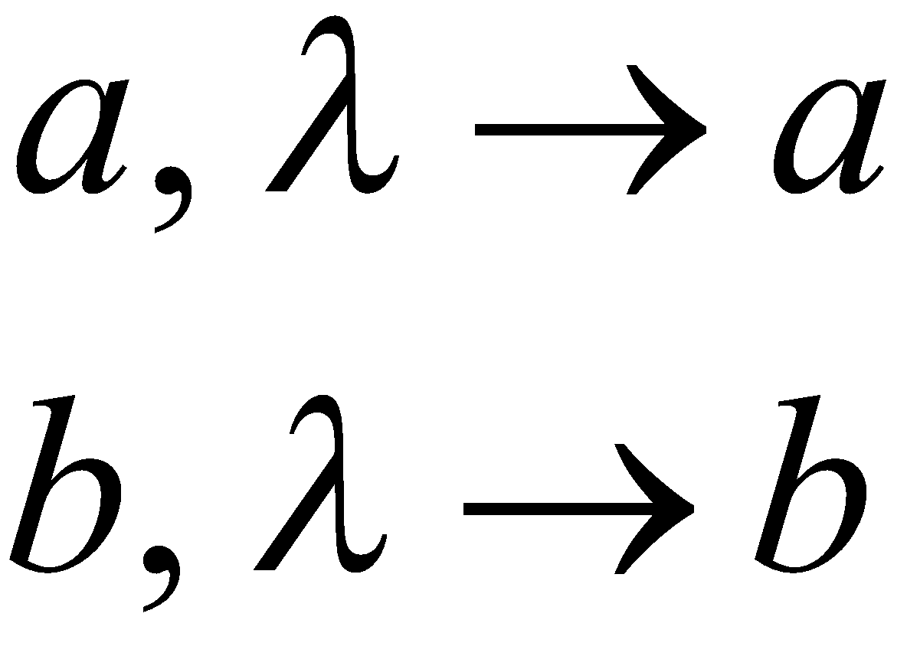
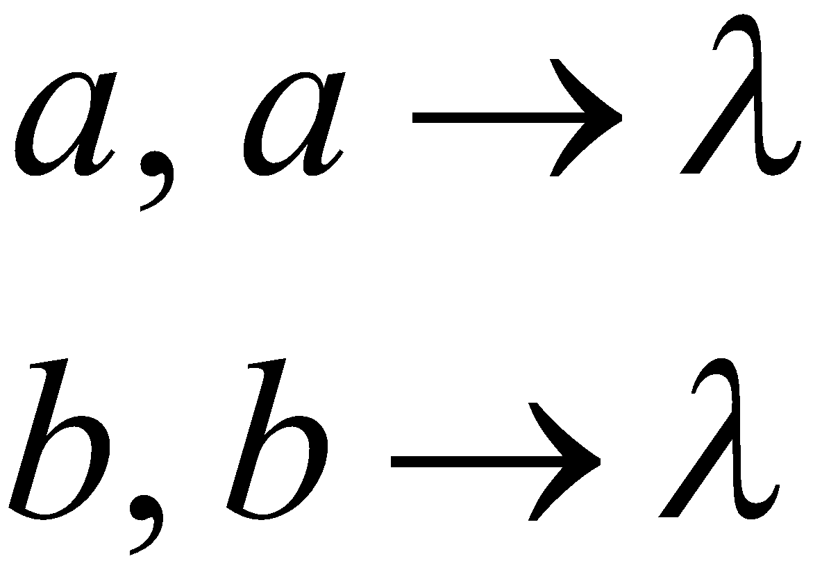
Another PDA example
PDA :
33

Slide 34
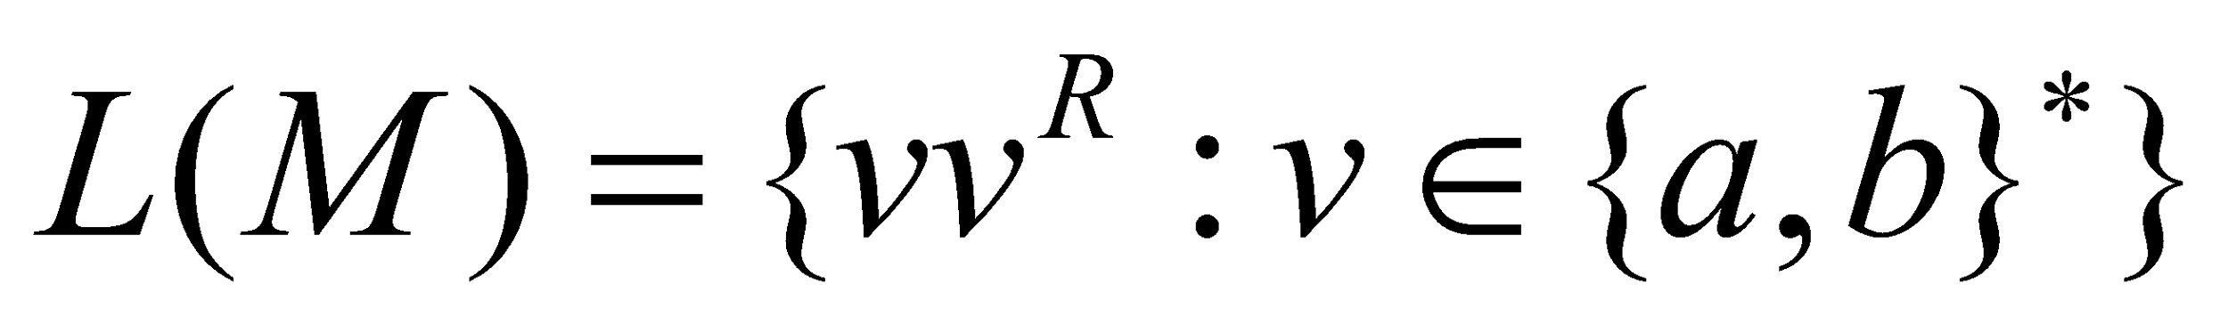
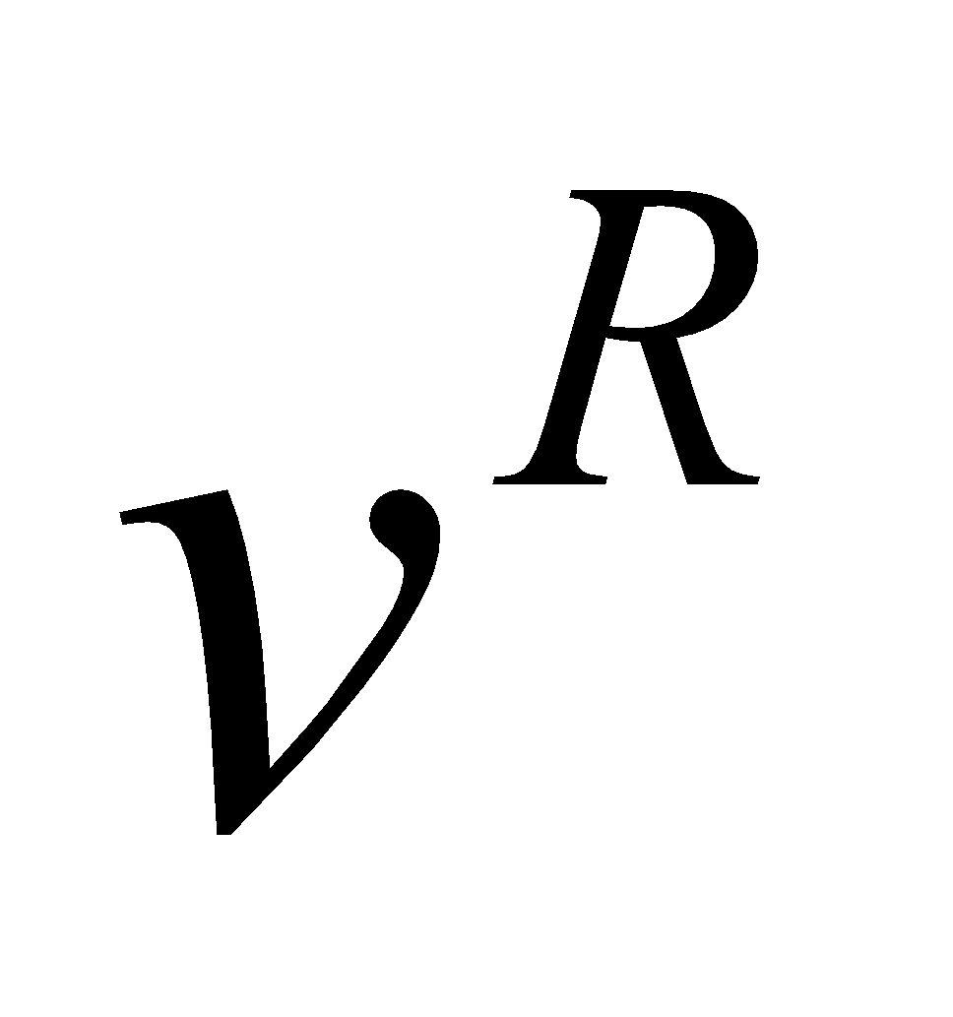
Basic Idea:
Push v
on stack
3. Match on input
with v on stack
2. Guess
middle
of input
4. Match
found
34

Slide 35
Execution Example:
Time 0
Input
Stack
35

Slide 36
Time 1
Input
Stack
36

Slide 37
Time 2
Input
Stack
37

Slide 38
Time 3
Input
Guess the middle
of string
Stack
38

Slide 39
Time 4
Input
Stack
39

Slide 40
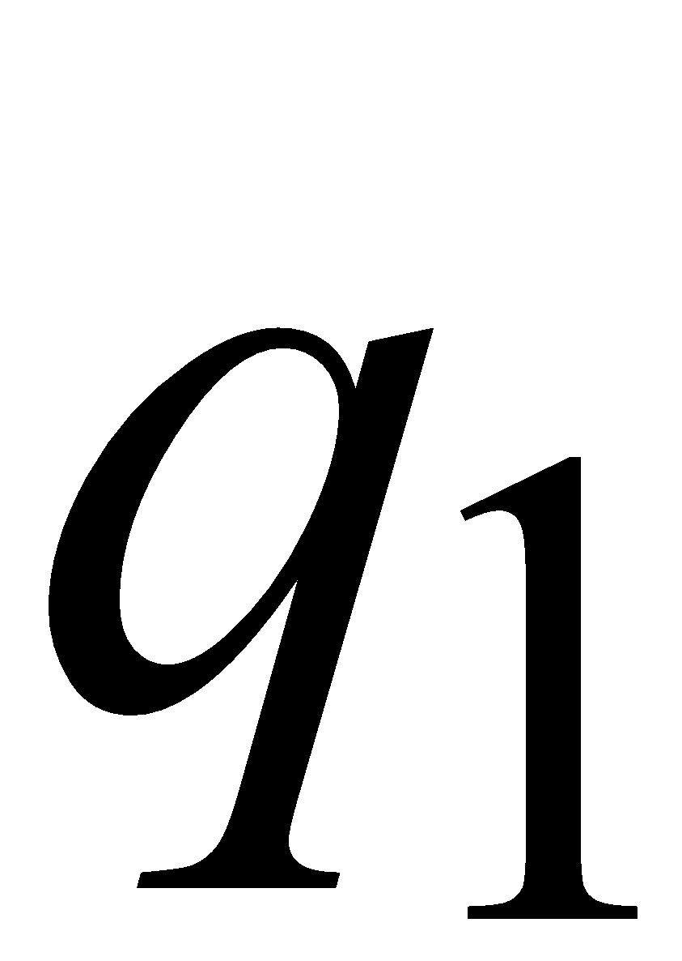
Time 5
Input
Stack
40

Slide 41
Time 6
Input
Stack
accept
41

Slide 42
Rejection Example:
Time 0
Input
Stack
42

Slide 43
Time 1
Input
Stack
43

Slide 44
Time 2
Input
Stack
44

Slide 45
Time 3
Input
Guess the middle
of string
Stack
45

Slide 46
Time 4
Input
Stack
46

Slide 47
Time 5
Input
There is no possible transition.
Input is not consumed
Stack
47

Slide 48
Another computation on same string:
Input
Time 0
Stack
48

Slide 49
Time 1
Input
Stack
49

Slide 50
Time 2
Input
Stack
50

Slide 51
Time 3
Input
Stack
51

Slide 52
Time 4
Input
Stack
52

Slide 53
Time 5
Input
No accept state
is reached
Stack
53

Slide 54
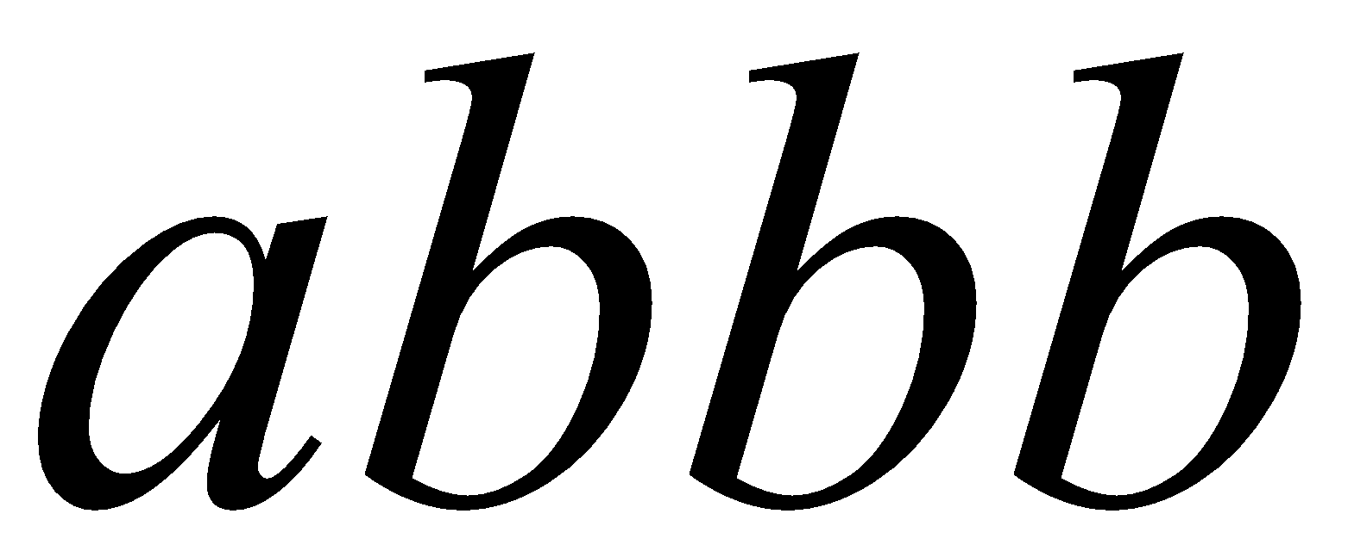
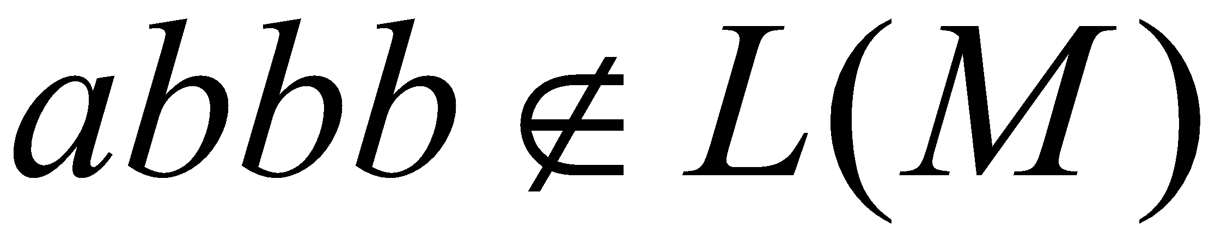
There is no computation
that accepts string
54

Slide 55
Homework
For the language {x | x = wcw^{r} and w in {0,1}*, but sigma={0,1,c}}
55

Slide 56
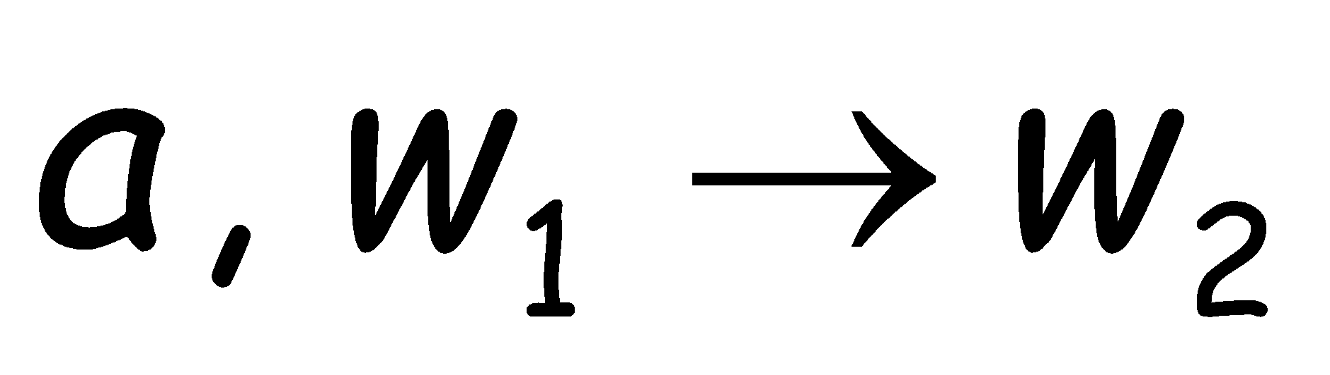
Pushing & Popping Strings
Pop
string
Input
symbol
Push
string
56

Slide 57
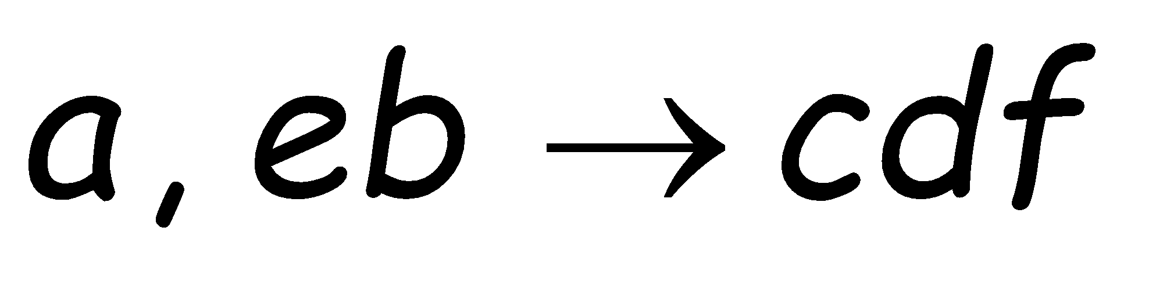


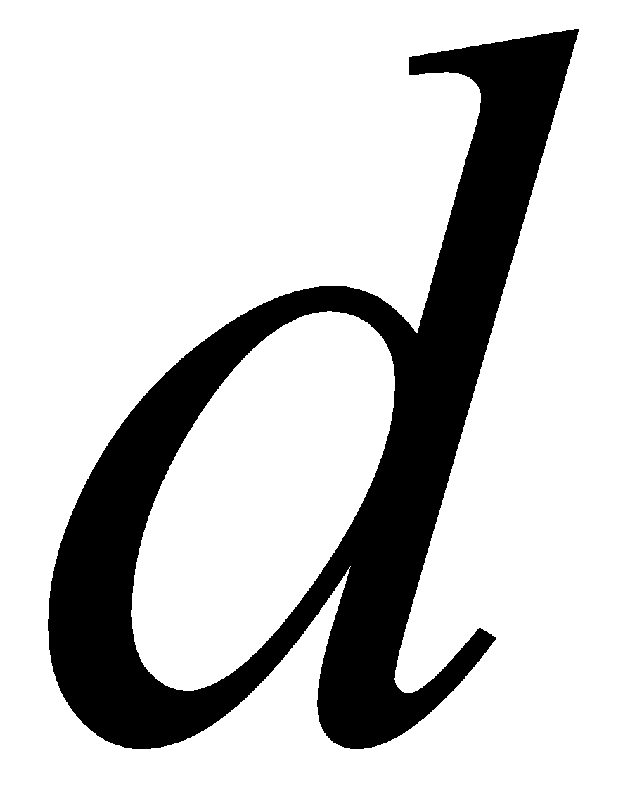
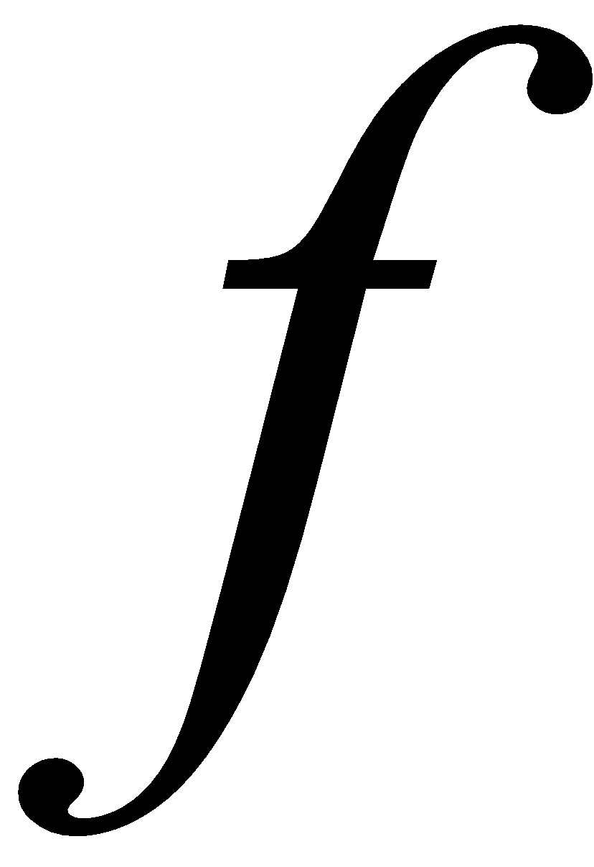
Example:
input
stack
top
push
string
top
pop
string
Replace
57

Slide 58
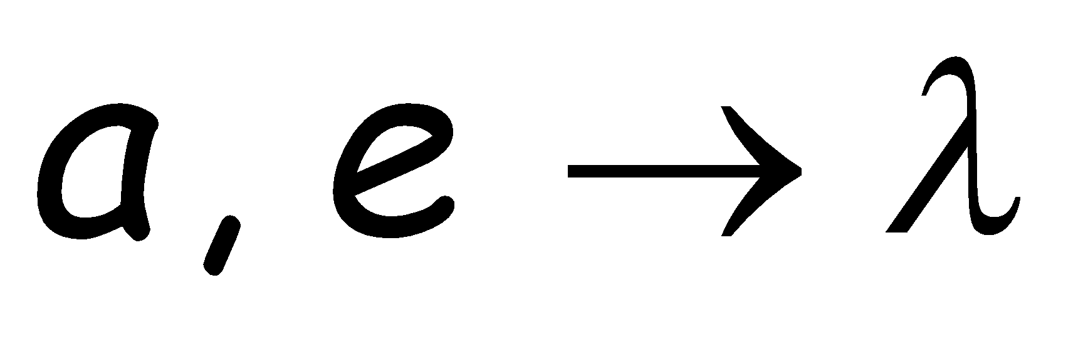
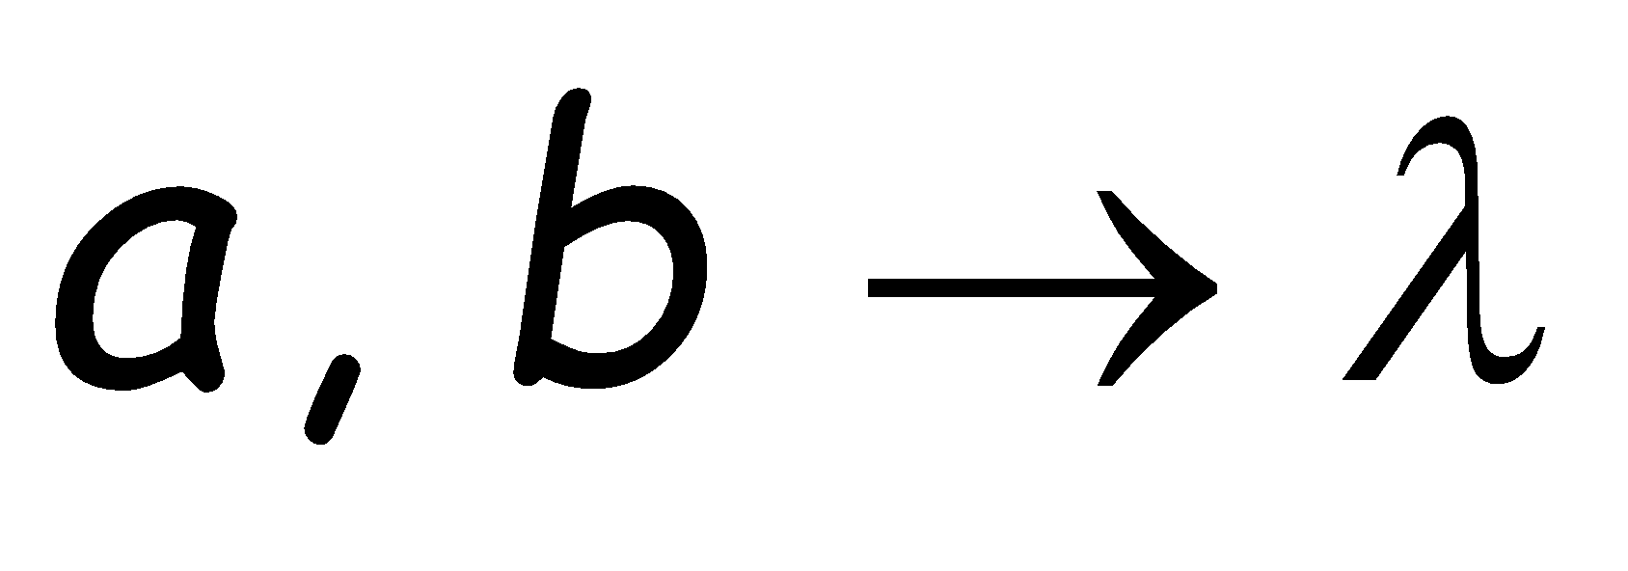
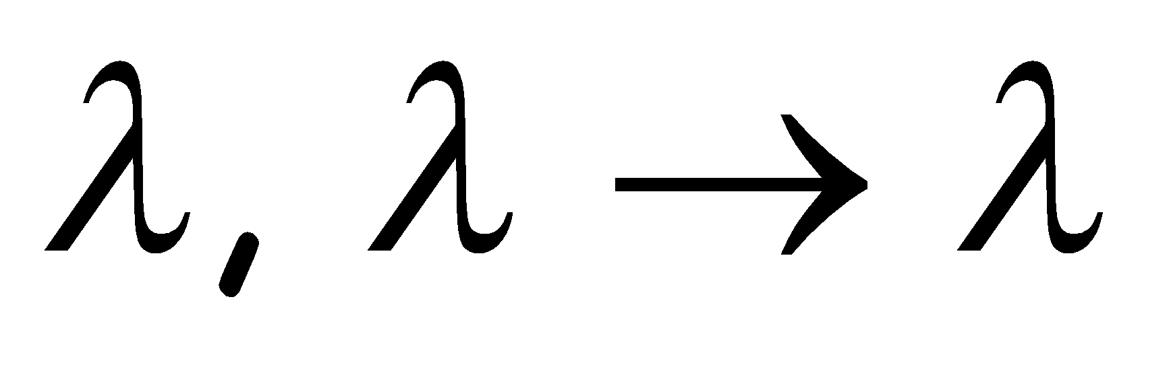
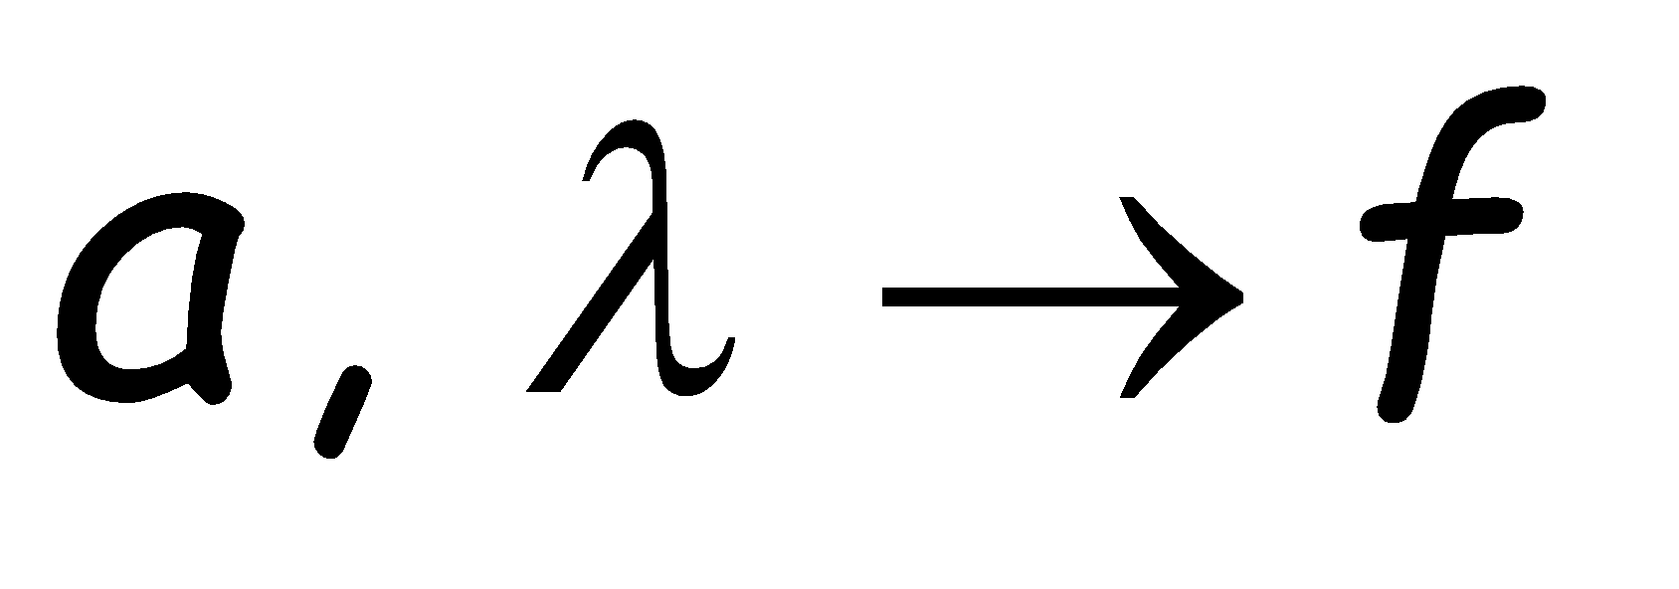
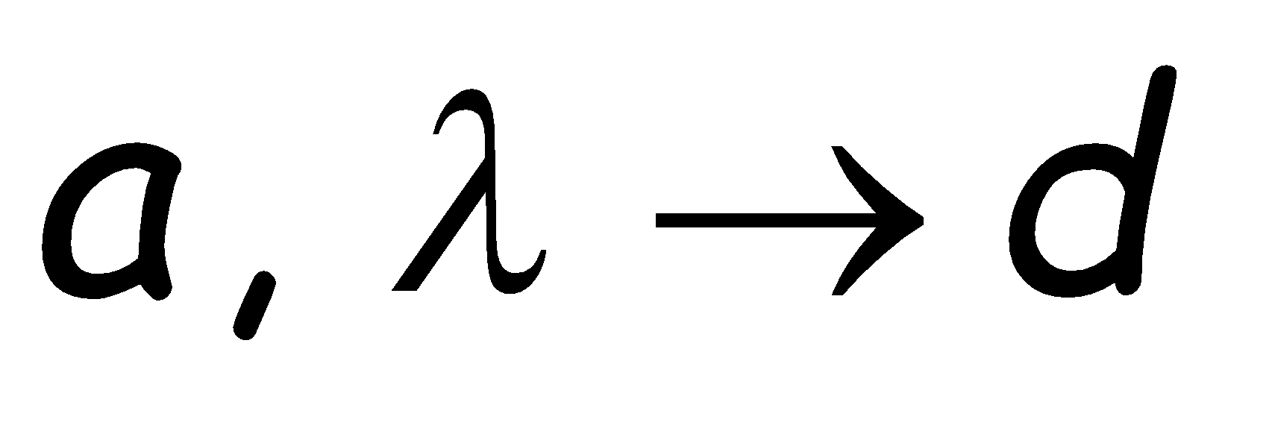
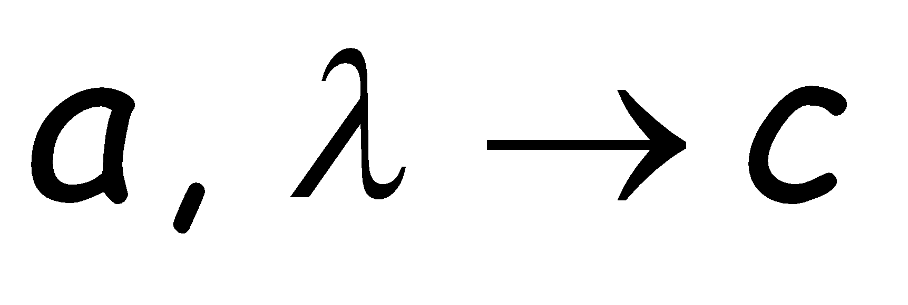
Equivalent
transitions
pop
push
58

Slide 59
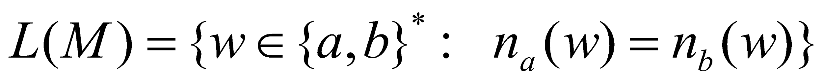
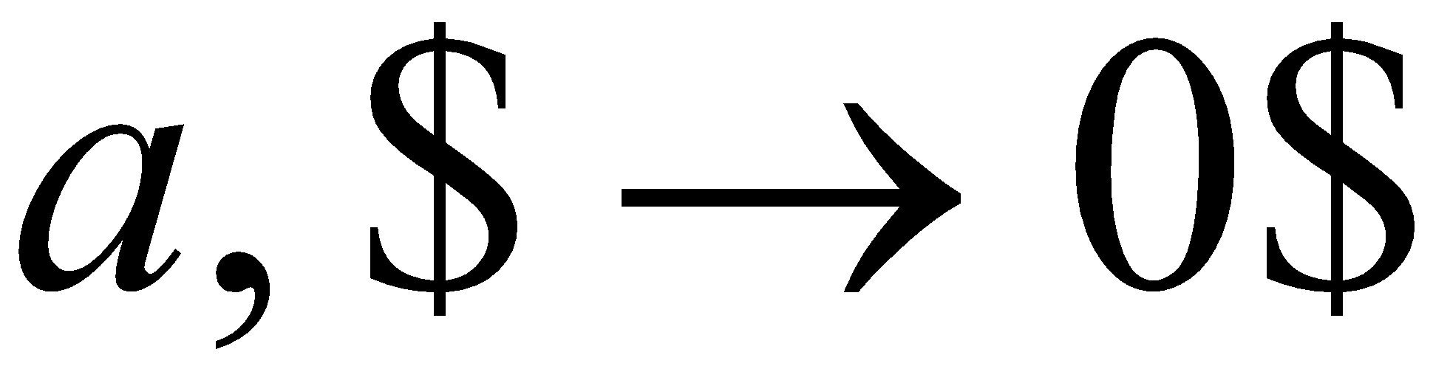
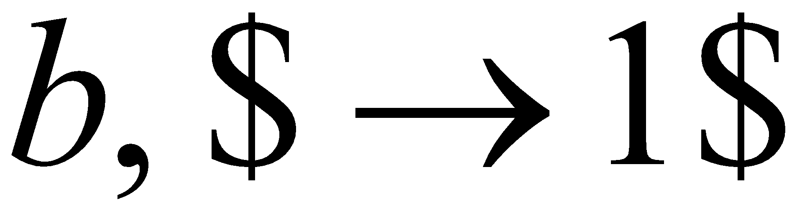
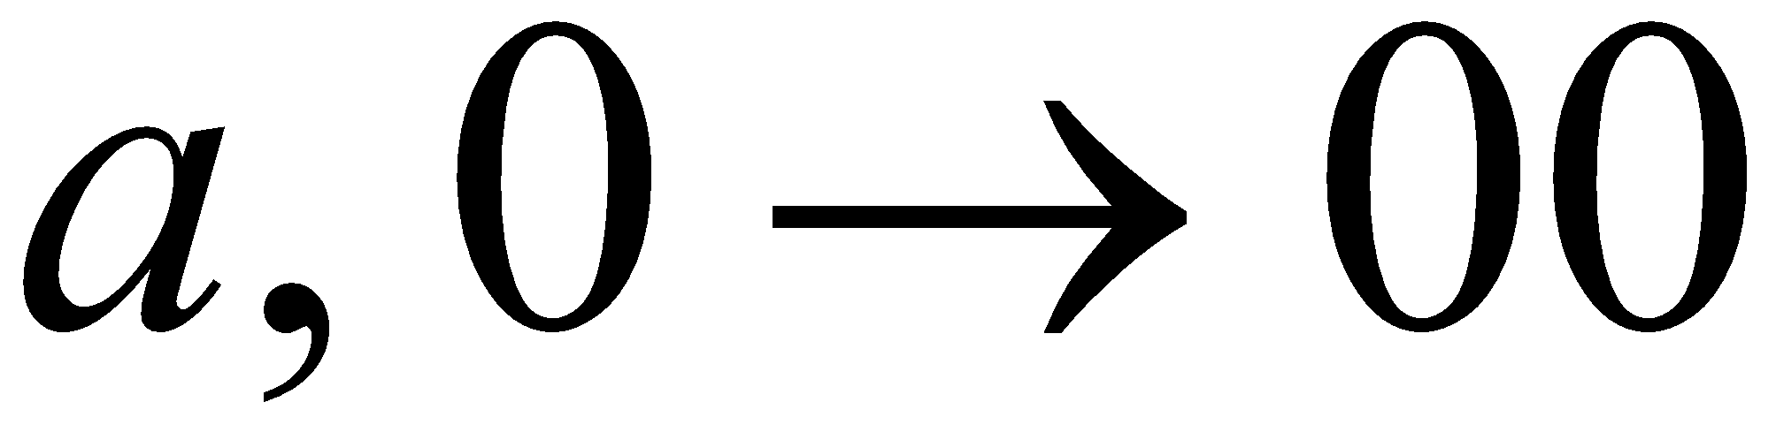
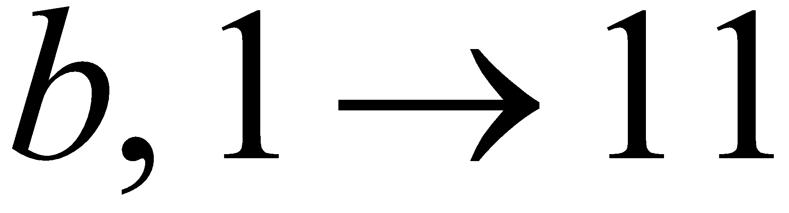
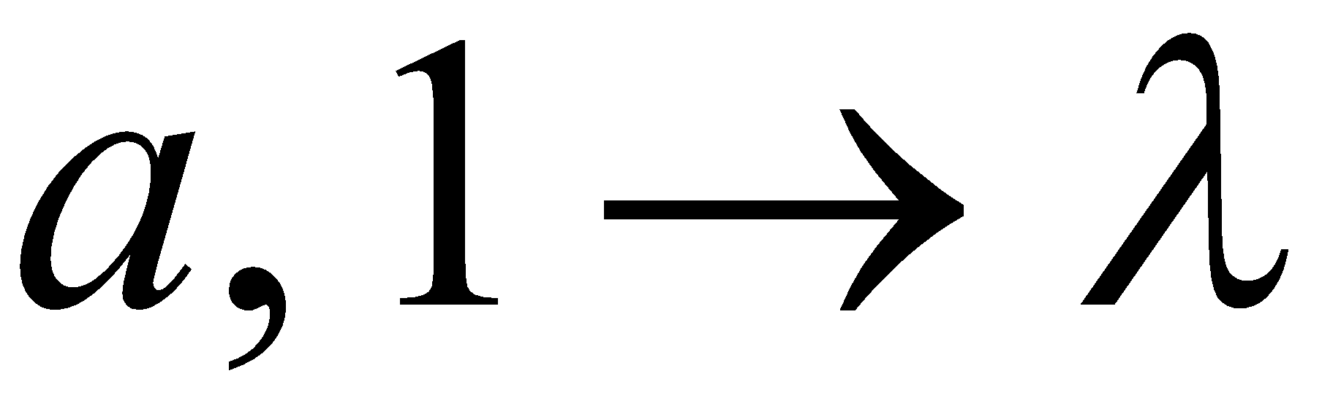
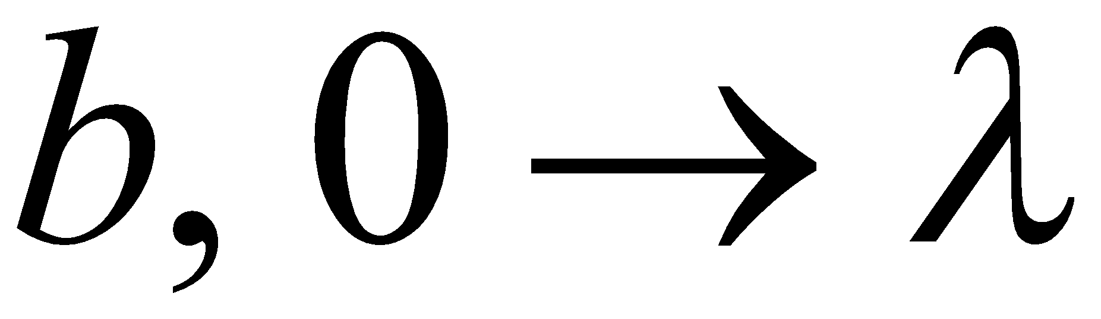
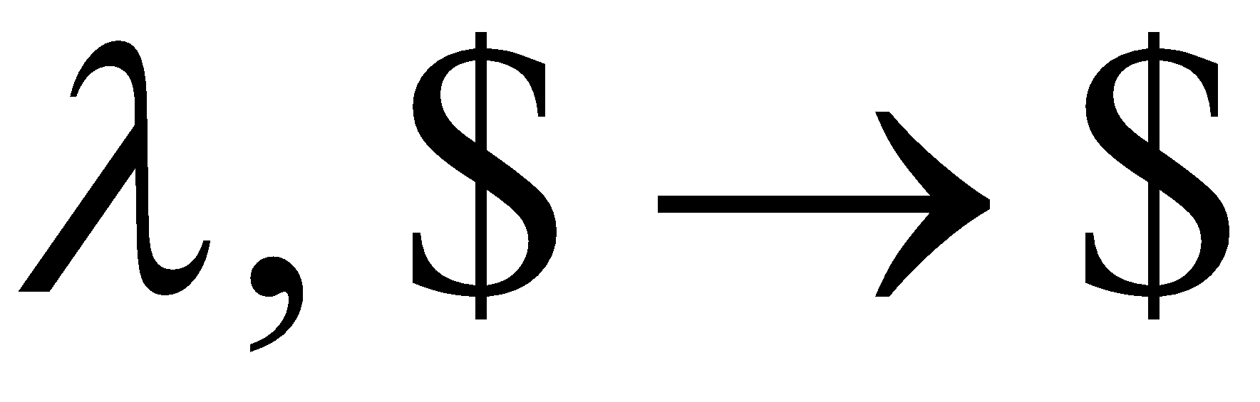
Another PDA example
PDA
59

Slide 60
Execution Example:
Time 0
Input
Stack
current
state
60

Slide 61

Time 1
Input
Stack
61

Slide 62

Time 3
Input
Stack
62

Slide 63

Time 4
Input
Stack
63

Slide 64
Time 5
Input
Stack
64

Slide 65
Time 6
Input
Stack
65

Slide 66
Time 7
Input
Stack
66

Slide 67
Time 8
Input
Stack
accept
67

Slide 68
Formalities for PDAs
68

Slide 69
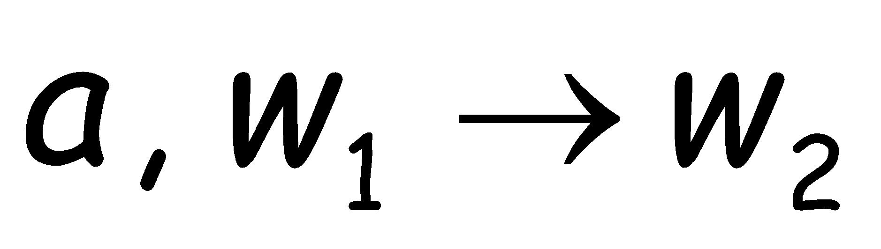
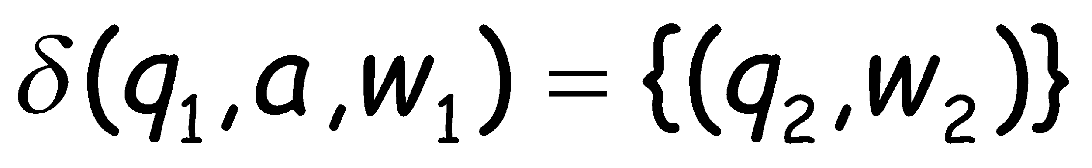
Transition function:
69

Slide 70





Transition function: Non deterministic
70

Slide 71

Instantaneous Description
Current
state
Current
stack
contents
Remaining
input
71

Slide 72

Example:
Instantaneous Description
Time 4:
Input
Stack
72

Slide 73

Example:
Instantaneous Description
Time 5:
Input
Stack
73

Slide 74
We write:
Time 4
Time 5
74

Slide 75

A computation:
75

Slide 76

For convenience we write:
76

Slide 77



Language of PDA
Language accepted by PDA :
Initial state
Accept state
77

Slide 78


Example:
PDA :
78

Slide 79


PDA :
79

Slide 80

Therefore:
PDA :
80

Slide 81
GNF to PDA
Example #1: Consider the following CFG in GNF.
S –> aS G is in GNF
S –> a L(G) = a⁺
Construct M as:
Q = {q}
Σ = T = {a}
Г = V = {S}
z = S
δ(q, a, S) = {(q, S), (q, ε)}
δ(q, ε, S) = Ø
Is δ complete?
81
Notes:
81
What is rule #10 used for – emptying the stack.
What is rule #9 used for – emptying the stack.
Why do rules #3 and #6 have options – you don’t know where the middle of the string is.
Why don’t rules #4 and #5 have similar options – suppose rule #4 had option (q₂, λ). Then 0100 would be accepted.

Slide 82
Example #2: Consider the following CFG in GNF.
(1) S –> aA
(2) S –> aB
(3) A –> aA G is in GNF
(4) A –> aB L(G) = a⁺ b⁺ // This looks ok to me, one, two or more a’s in the start
(5) B –> bB
(6) B –> b [Can you write a simpler equivalent CFG? Will it be GNF?]
Construct M as:
Q = {q}
Σ = T = {a, b}
Г = V = {S, A, B}
z = S
(1) δ(q, a, S) = {(q, A), (q, B)} From productions #1 and 2, S->aA, S->aB
(2) δ(q, a, A) = {(q, A), (q, B)} From productions #3 and 4, A->aA, A->aB
(3) δ(q, a, B) = Ø
(4) δ(q, b, S) = Ø
(5) δ(q, b, A) = Ø
(6) δ(q, b, B) = {(q, B), (q, ε)} From productions #5 and 6, B->bB, B->b
(7) δ(q, ε, S) = Ø
(8) δ(q, ε, A) = Ø
(9) δ(q, ε, B) = Ø Is δ complete?
82
Notes:
82
What is rule #10 used for – emptying the stack.
What is rule #9 used for – emptying the stack.
Why do rules #3 and #6 have options – you don’t know where the middle of the string is.
Why don’t rules #4 and #5 have similar options – suppose rule #4 had option (q₂, λ). Then 0100 would be accepted.

Slide 83
Another Example: Using the PDA from example #2:
(q, aabb, S) |— (q, abb, A) (1)/1
|— (q, bb, B) (2)/2
|— (q, b, B) (6)/1
|— (q, ε, ε) (6)/2
The corresponding derivation using the grammar:
S => aA (1)
=> aaB (4)
=> aabB (5)
=> aabb (6)
83
Notes:
83
What is rule #10 used for – emptying the stack.
What is rule #9 used for – emptying the stack.
Why do rules #3 and #6 have options – you don’t know where the middle of the string is.
Why don’t rules #4 and #5 have similar options – suppose rule #4 had option (q₂, λ). Then 0100 would be accepted.

Slide 84
Homework
Construct PDA to GNF
(1) S –> aABC
(2) A –> a
(3) B –> b
(4) C –> cAB
(5) C –> cC
PDA recognizes {a^{i}b^{j}c^{k}| i=j or i=k}
Construct a PDA that recognizes:
L = {a^{i}b^{j}c^{i+j}| i,j Є0}
Construct a PDA that recognizes: L = {a^{i}b^{j}| i>0 and j=i+3}
84

Slide 85
CA test 2 – Co3
Part a- define PDA, CFG, derivations, ambiguous grammar, not CFG (pumping lemma)
Part b – construct PDA
Part c – CNF and GNF
85

